Slide 1

Session 13
Generics and Iterators

Slide 2

Objectives
Define and describe generics
Explain creating and using generics
Explain iterators

Slide 3
Generics
Generics are a kind of parameterized data structures that can work with value types as well as reference types.
You can define a class, interface, structure, method, or a delegate as a generic type in C#.
Consider a C# program that uses an array variable of type Object to store a collection of student names.
The names are read from the console as value types and are boxed to enable storing each of them as type Object.
In this case, the compiler cannot verify the data stored against its data type as it allows you to cast any value to and from Object.
If you enter numeric data, it will be accepted without any verification.
To ensure type-safety, C# introduces generics, which has a number of features including the ability to allow you to define generalized type templates based on which the type can be constructed later.
Example

Slide 4
Namespaces, Classes, and Interfaces for Generics 1-3
There are several namespaces in the .NET Framework that facilitate creation and use of generics which are as follows:
Classes:
The System.Collections.Generic namespace consists of classes that allow you to create type-safe collections.
System.Collections.ObjectModel
This allows you to create dynamic and read-only generic collections.
System.Collections.Generic
The namespace consists of classes and interfaces that allow you to define customized generic collections.

Slide 5
Namespaces, Classes, and Interfaces for Generics 2-3
The following table lists some of the widely used classes of the System.Collections.Generic namespace:
Class | Descriptions
Comparer | Is an abstract class that allows you to create a generic collection by implementing the functionalities of the IComparer interface
Dictionary.KeyCollection | Consists of keys present in the instance of the Dictionary class
Dictionary.ValueCollection | Consists of values present in the instance of the Dictionary class
EqualityComparer | Is an abstract class that allows you to create a generic collection by implementing the functionalities of the IEqualityComparer interface

Slide 6
Namespaces, Classes, and Interfaces for Generics 3-3
Interfaces
The System.Collections.Generic namespace consists of interfaces that allow you to create type-safe collections.
The following table lists some of the widely used interfaces of the System.Collections.Generic namespace:
Interface | Descriptions
IComparer | Defines a generic method Compare() that compares values within a collection
IEnumerable | Defines a generic method GetEnumerator() that iterates over a collection
IEqualityComparer | Consists of methods which check for the equality between two objects

Slide 7
System.Collections.ObjectModel 1-5
The System.Collections.ObjectModel namespace consists of classes that can be used to create customized generic collections.
The following table shows the classes contained in the System.Collections.ObjectModel namespace:
Classes | Descriptions
Collection<> | Provides the base class for generic collections
KeyedCollection<> | Provides an abstract class for a collection whose keys are associated with values
ReadOnlyCollection<> | Is a read-only generic base class that prevents modification of collection

Slide 8
System.Collections.ObjectModel 2-5
The following code demonstrates the use of the ReadOnlyCollection<> class:
Snippet
using System;
using System.Collections;
using System.Collections.Generic;
using System.Collections.ObjectModel;
class ReadOnly
{
static void Main(string[] args)
{
List<string> objList = new List<string>();
objList.Add("Francis");
objList.Add("James");
objList.Add("Baptista");
objList.Add("Micheal");
ReadOnlyCollection<string> objReadOnly = new
ReadOnlyCollection
<string>(objList);
Console.WriteLine("Values stored in the read only
collection");
foreach (string str in objReadOnly)
{
Console.WriteLine(str);
}
Console.WriteLine();

Slide 9
System.Collections.ObjectModel 3-5
Console.WriteLine("Total number of elements in the read
only collection: " + objReadOnly.Count);
if (objList.Contains("Francis"))
{
objList.Insert(2, "Peter");
}
Console.WriteLine("\nValues stored in the list after
modification");
foreach (string str in objReadOnly)
{
Console.WriteLine(str);
}
string[] array = new string[objReadOnly.Count * 2];
objReadOnly.CopyTo(array, 5);
Console.WriteLine("\nTotal number of values that can be
stored in the new array: " + array.Length);
Console.WriteLine("Values in the new array");
foreach (string str in array)
{
if (str == null)
{
Console.WriteLine ("null");
}
else
{
Console.WriteLine(str);
}
}
}
}

Slide 10
System.Collections.ObjectModel 4-5
In the code:
The Main()method of the ReadOnly class creates an instance of the List class.
The Add() method inserts elements in the instance of the List class.
An instance of the ReadOnlyCollection class of type String is created and the elements stored in the instance of the List class are copied to the instance of the ReadOnlyCollection class.
The Contains()method checks whether the List class contains the specified element.
If the List class contains the specified element, Francis, then the new element, Peter, is inserted at the specified index position, 2.
The code creates an array variable that is twice the size of the ReadOnlyCollection class.
The CopyTo() method copies the elements from the ReadOnlyCollection class to the array variable from the fifth position onwards.

Slide 11
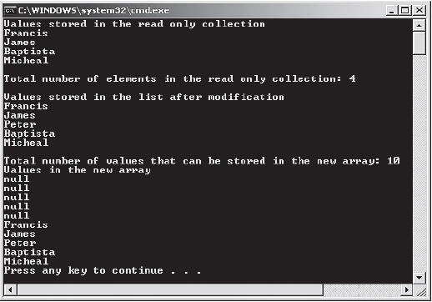
System.Collections.ObjectModel 5-5
The following figure displays the output of the code:
Output

Slide 12
Creating Generic Types
Following are the features of a generic declaration:
A generic declaration always accepts a type parameter, which is a placeholder for the required data type.
The type is specified only when a generic type is referred to or constructed as a type within a program.
The process of creating a generic type begins with a generic type definition containing type parameters that acts like a blueprint.
Later, a generic type is constructed from the definition by specifying actual types as the generic type arguments, which will substitute for the type parameters or the placeholders.

Slide 13

Benefits
Generics ensure type-safety at compile-time.
Generics allow you to reuse the code in a safe manner without casting or boxing.
A generic type definition is reusable with different types but can accept values of a single type at a time.
Apart from reusability, there are several other benefits of using generics. These are as follows:
Improved performance because of low memory usage as no casting or boxing operation is required to create a generic
Ensured strongly-typed programming model
Reduced run-time errors that may occur due to casting or boxing

Slide 14
Generic Classes 1-5
Generic classes define functionalities that can be used for any data type and are declared with a class declaration followed by a type parameter enclosed within angular brackets.
While declaring a generic class, you can apply some restrictions or constraints to the type parameters by using the where keyword. However, applying constraints to the type parameters is optional.
Thus, while creating a generic class, you must generalize the data types into the type parameter and optionally decide the constraints to be applied on the type parameter.
The following syntax is used for creating a generic class:
where,
access_modifier: Specifies the scope of the generic class. It is optional.
ClassName: Is the name of the new generic class to be created.
<type parameter list>: Is used as a placeholder for the actual data type.
type parameter constraint clause: Is an optional class or an interface applied to the type parameter with the where keyword.
Syntax
<access_modififer> class <ClassName><<type parameter list>> [where <type parameter constraint clause>]

Slide 15
Generic Classes 2-5
The following code creates a generic class that can be used for any specified data type:
Snippet
using System;
using System.Collections.Generic;
class General<T>
{
T[] values;
int _counter = 0;
public General(int max)
{
values = new T[max];
}
public void Add(T val)
{
if (_counter < values.Length)
{
values[_counter] = val;
_counter++;
}
}
public void Display()

Slide 16
Generic Classes 3-5
{
Console.WriteLine(“Constructed Class is of type: “ +
typeof(T));
Console.WriteLine(“Values stored in the object of
constructed class are: “);
for (int i = 0; i < values.Length; i++)
{
Console.WriteLine(values[i]);
}
}
}
class Students
{
static void Main(string[] args)
{
General<string> objGeneral = new General<string>(3);
objGeneral.Add(“John”);
objGeneral.Add(“Patrick”);
objGeneral.Display();
General<int> objGeneral2 = new General<int>(2);
objGeneral2.Add(200);
objGeneral2.Add(35);
objGeneral2.Display();
}
}

Slide 17
Generic Classes 4-5
In the code:
A generic class definition for General is created that takes a type parameter T.
The generic class declares a parameterized constructor with an int value.
The Add()method takes a parameter of the same type as the generic class.
The method Display()displays the value type specified by the type parameter and the values supplied by the user through the object.
The Main()method of the class Students creates an instance of the generic class General by providing the type parameter value as string and total value to be stored as 3.
This instance invokes the Add()method which takes student names as values.
These student names are displayed by invoking the Display()method.
Later, another object is created of a different data type, int, based on the same class definition.
The class definition is generic, we need not change the code now, but can reuse the same code for an int data type as well.
Thus, using the same generic class definition, we can create two different lists of data.

Slide 18
Generic Classes 5-5
Constructed Class is of type: System.String
Values stored in the object of constructed class are:
John
Patrick
Constructed Class is of type: System.Int32
Values stored in the object of constructed class are:
200
35
Output

Slide 19
Constraints on Type Parameters 1-4
You can apply constraints on the type parameter while declaring a generic type.
A constraint is a restriction imposed on the data type of the type parameter and are specified using the where keyword.
They are used when the programmer wants to limit the data types of the type parameter to ensure consistency and reliability of data in a collection.
The following table lists the types of constraints that can be applied to the type parameter:
Constraints | Descriptions
T : struct | Specifies that the type parameter must be of a value type only except the null value
T : class | Specifies that the type parameter must be of a reference type such as a class, interface, or a delegate
T : new() | Specifies that the type parameter must consist of a constructor without any parameter which can be invoked publicly
T : <base class name> | Specifies that the type parameter must be the parent class or should inherit from a parent class
T : <interface name> | Specifies that the type parameter must be an interface or should inherit an interface

Slide 20
Constraints on Type Parameters 2-4
The following code creates a generic class that uses a class constraint:
Snippet
using System;
using System.Collections.Generic;
class Employee
{
string _empName;
int _empID;
public Employee(string name, int num)
{
_empName = name;
_empID = num;
}
public string Name
{
get
{
return _empName;
}
}
public int ID
{
get
{
return _empID;
}
}
}

Slide 21
Constraints on Type Parameters 3-4
class GenericList<T> where T : Employee
{
T[] _name = new T[3];
int _counter = 0;
public void Add(T val)
{
_name[_counter] = val;
_counter++;
}
public void Display()
{
for (int i = 0; i < _counter; i++)
{
Console.WriteLine(_name[i].Name + “, “ + _name[i].ID);
}
}
}
class ClassConstraintDemo
{
static void Main(string[] args)
{
GenericList<Employee> objList = new
GenericList<Employee>();
objList.Add(new Employee(“John”, 100));
objList.Add(new Employee(“James”, 200));
objList.Add(new Employee(“Patrich”, 300));
objList.Display();
}
}

Slide 22
Constraints on Type Parameters 4-4
In the code:
The class GenericList is created that takes a type parameter T.
This type parameter is applied a class constraint, which means the type parameter can only include details of the Employee type.
The generic class creates an array variable with the type parameter T, which means it can include values of type Employee.
The Add()method consists of a parameter val, which will contain the values set in the Main()method.
Since, the type parameter should be of the Employee type, the constructor is called while setting the values in the Main() method.
John, 100
James, 200
Patrich, 300
Output

Slide 23
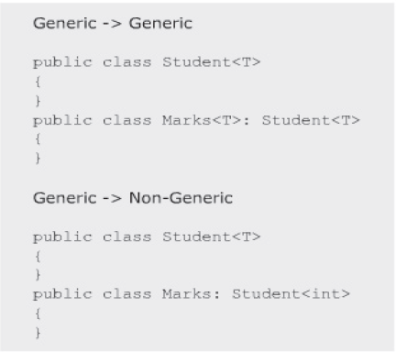
Inheriting Generic Classes 1-2
A generic class can be inherited same as any other non-generic class in C# and can act both as a base class or a derived class.
While inheriting a generic class in another generic class, you can use the generic type parameter of the base class instead of passing the data type of the parameter.
However, while inheriting a generic class in a non-generic class, you must provide the data type of the parameter instead of the base class generic type parameter.
The constraints imposed at the base class level must be included in the derived generic class.
The following figure displays a generic class as base class:

Slide 24
Inheriting Generic Classes 2-2
The following syntax is used to inherit a generic class from an existing generic class:
where,
access_modifier: Specifies the scope of the generic class.
BaseClass: Is the generic base class.
<generic type parameter>: Is a placeholder for the specified data type.
DerivedClass: Is the generic derived class.
The following syntax is used to inherit a non-generic class from a generic class:
where,
<type parameter value>: Can be a data type such as int, string, or float.
Syntax
<access_modifier> class <BaseClass><<generic type parameter>>{}
<access_modifier> class <DerivedClass> : <BaseClass><<generic type parameter>>{}
Syntax
<access_modifier> class <BaseClass><<generic type parameter>>{}
<access_modifier> class <DerivedClass> : <BaseClass><<type parameter value>>{}

Slide 25
Generic Methods 1-3
Generic methods process values whose data types are known only when accessing the variables that store these values.
A generic method is declared with the generic type parameter list enclosed within angular brackets.
Defining methods with type parameters allow you to call the method with a different type everytime.
You can declare a generic method within generic or non-generic class declarations.
When you declare a generic method within a generic class declaration, the body of the method refers to the type parameters of both, the method and class declaration.
Generic methods can be declared with the following keywords:
Virtual: The generic methods declared with the virtual keyword can be overridden in the derived class.
Override: The generic method declared with the override keyword overrides the base class method. However, while overriding, the method does not specify the type parameter constraints since the constraints are overridden from the overridden method.
Abstract: The generic method declared with the abstract keyword contains only the declaration of the method. Such methods are typically implemented in a derived class.

Slide 26
Generic Methods 2-3
The following syntax is used for declaring a generic method:
where,
access_modifier: Specifies the scope of the method.
return_type: Determines the type of value the generic method will return.
MethodName: Is the name of the generic method.
<type parameter list>:Is used as a placeholder for the actual data type.
Syntax
<access_modifier><return_type><MethodName><<type parameter list>>

Slide 27
Generic Methods 3-3
The following code creates a generic method within a non-generic class:
In the code:
The class SwapNumbers consists of a generic method Swap()that takes a type parameter T within angular brackets and two parameters within parenthesis of type T.
The Swap()method creates a variable temp of type T that is assigned the value within the variable valOne.
The Main()method displays the values initialized within variables and calls the Swap()method by providing the type int within angular brackets.
This will substitute for the type parameter in the generic method definition and will display the swapped values within the variables.
Values before swapping: 23 & 45
Values after swapping: 45 & 23
Snippet
using System;
using System.Collections.Generic;
class SwapNumbers{
static void Swap<T>(ref T valOne, ref T valTwo) {
T temp = valOne;
valOne = valTwo;
valTwo = temp;
}
static void Main(string[] args) {
int numOne = 23;
int numTwo = 45;
Console.WriteLine(“Values before swapping: “ + numOne + “ & “ + numTwo);
Swap<int>(ref numOne, ref numTwo);
Console.WriteLine(“Values after swapping: “ + numOne + “ & “ + numTwo);
}
}
Output

Slide 28
Generic Interfaces 1-4
Following are the features of generic interfaces:
Useful for generic collections or generic classes representing the items in the collection.
Generic Interfaces
The syntax for declaring an interface is similar to the syntax for class declaration.
Useful for the generic classes with the generic interfaces to avoid boxing and unboxing operations on the value types.
Can implement the generic interfaces and inheritance by passing the required parameters specified in the interface.

Slide 29
Generic Interfaces 2-4
The following syntax is used for creating a generic interface:
where,
access_modifier: Specifies the scope of the generic interface.
InterfaceName: Is the name of the new generic interface.
<type parameter list>: Is used as a placeholder for the actual data type.
type parameter constraint clause: Is an optional class or an interface applied to the type parameter with the where keyword.
Syntax
<access_modifier> interface <InterfaceName><<type parameter list>> [where <type parameter constraint clause>]

Slide 30
Generic Interfaces 3-4
The following code creates a generic interface that is implemented by the non-generic class:
Snippet
using System;
using System.Collections.Generic;
interface IMaths<T>{
T Addition(T valOne, T valTwo);
T Subtraction(T valOne, T valTwo);
}
class Numbers : IMaths<int>{
public int Addition(int valOne, int valTwo)
{
return valOne + valTwo;
}
public int Subtraction(int valOne, int valTwo){
if (valOne > valTwo){
return (valOne - valTwo);
}
else{
return (valTwo - valOne);
}
}
static void Main(string[] args){
int numOne = 23;
int numTwo = 45;
Numbers objInterface = new Numbers();
Console.Write(“Addition of two integer values is: “);
Console.WriteLine(objInterface.Addition(numOne, numTwo));
Console.Write(“Subtraction of two integer values is: “);
Console.WriteLine(objInterface.Subtraction(numOne, numTwo));
}
}

Slide 31
Generic Interfaces 4-4
In the code:
The generic interface IMaths takes a type parameter T and declares two methods of type T.
The class Numbers implements the interface IMaths by providing the type int within angular brackets and implements the two methods declared in the generic interface.
The Main()method creates an instance of the class Numbers and displays the addition and subtraction of two numbers.
Addition of two integer values is: 68
Subtraction of two integer values is: 22
Output

Slide 32
Generic Interface Constraints 1-4
You can specify an interface as a constraint on a type parameter to enable the members of the interface within, to use the generic class.
In addition, it ensures that only the types that implement the interface are used and also specify multiple interfaces as constraints on a single type parameter.

Slide 33
Generic Interface Constraints 2-4
The following code creates a generic interface that is used as a constraint on a generic class:
Snippet
using System;
using System.Collections.Generic;
interface IDetails
{
void GetDetails();
}
class Student : IDetails
{
string _studName;
int _studID;
public Student(string name, int num)
{
_studName = name;
_studID = num;
}
public void GetDetails()
{
Console.WriteLine(_studID + “\t” + _studName);
}
}

Slide 34
Generic Interface Constraints 3-4
class GenericList<T> where T : IDetails
{
T[] _values = new T [3];
int _counter = 0;
public void Add(T val)
{
_values[_counter] = val;
_counter++;
}
public void Display()
{
for (int i = 0; i < 3; i++)
{
_values[i].GetDetails();
}
}
}
class InterfaceConstraintDemo
{
static void Main(string[] args)
{
GenericList<Student> objList = new GenericList<Student>();
objList.Add(new Student(“Wilson”, 120));
objList.Add(new Student(“Jack”, 130));
objList.Add(new Student(“Peter”, 140));
objList.Display();
}
}

Slide 35
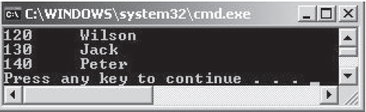
Generic Interface Constraints 4-4
In the code:
An interface Idetails declares a method GetDetails().
The class Student implements the interface IDetails.
The class GenericList is created that takes a type parameter T.
This type parameter is applied an interface constraint, which means the type parameter can only include details of the Idetails type.
The Main() method creates an instance of the class GenericList by passing the type parameter value as Student, since the class Student implements the interface IDetails.
The following figure shows the output of the code to create a generic interface:

Slide 36
Generic Delegates 1-4
Delegates are reference types that encapsulate a reference to a method that has a signature and a return type.
Following are the features of a generic delegate:
Delegates can also be declared as generic.
It can be used to refer to multiple methods in a class with different types of parameters.
The number of parameters of the delegate and the referenced methods must be the same.
The type parameter list is specified after the delegate’s name in the syntax.

Slide 37
Generic Delegates 2-4
The following syntax is used to declare a generic delegate:
where,
return_type: Determines the type of value the delegate will return.
DelegateName: Is the name of the generic delegate.
type parameter list: Is used as a placeholder for the actual data type.
argument_list: Specifies the parameter within the delegate.
Syntax
delegate <return_type><DelegateName><type parameter list>(<argument_list>);

Slide 38
Generic Delegates 3-4
The following code declares a generic delegate:
Snippet
using System;
delegate T DelMath<T>(T val);
class Numbers
{
static int NumberType(int num)
{
if(num % 2 == 0)
return num;
else
return (0);
}
static float NumberType(float num)
{
return num % 2.5F;
}
public static void Main(string[] args)
{
DelMath<int> objDel = NumberType;
DelMath<float> objDel2 = NumberType;
Console.WriteLine(objDel(10));
Console.WriteLine(objDel2(108.756F));
}
}

Slide 39
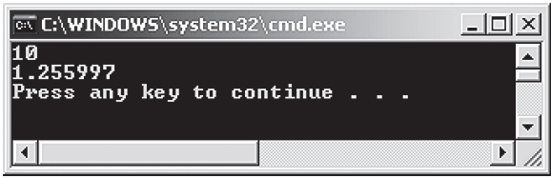
Generic Delegates 4-4
In the code:
A generic delegate is declared in the Numbers class.
In the Main() method of the class, an object of the delegate is created, which is referring to the NumberType() method and takes the parameter of int type.
An integer value is passed to the method, which displays the value only if it is an even number.
Another object of the delegate is created in the Main() method, which is referring to the NumberType() method and takes the parameter of float type.
A float value is passed to the method, which displays the remainder of the division operation. Therefore, generic delegates can be used for overloaded methods.
The following figure shows the output of the code to declare a generic delegate:

Slide 40
Overloading Methods Using Type Parameters 1-3
Methods of a generic class that take generic type parameters can be overloaded.
The programmer can overload the methods that use type parameters by changing the type or the number of parameters.
However, the type difference is not based on the generic type parameter, but is based on the data type of the parameter passed.

Slide 41
Overloading Methods Using Type Parameters 2-3
The following code demonstrates how to overload methods that use type parameters:
Snippet
using System;
using System.Collections;
using System.Collections.Generic;
class General<T, U>{
T _valOne;
U _valTwo;
public void AcceptValues(T item) {
_valOne = item;
}
public void AcceptValues(U item) {
_valTwo = item;
}
public void Display() {
Console.Write(_valOne + "\t" + _valTwo);
}
}
class MethodOverload{
static void Main(string[] args) {
General<int, string> objGenOne = new General<int, string>();
objGenOne.AcceptValues(10);
objGenOne.AcceptValues("Smith");
Console.WriteLine("ID\tName\tDesignation\tSalary");
objGenOne.Display();
General<string, float> objGenTwo = new General<string, float>();
objGenTwo.AcceptValues("Mechanic");
objGenTwo.AcceptValues(2500);
Console.Write("\t");
objGenTwo.Display();
Console.WriteLine();
}
}

Slide 42
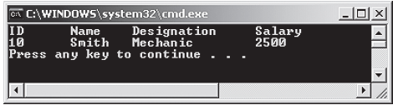
Overloading Methods Using Type Parameters 3-3
In the code:
The General class has two overloaded methods with different type parameters.
In the Main() method, the instance of the General class is created. The class is initialized by specifying the data type for the generic parameters T and U as string and int respectively.
The overloaded methods are invoked by specifying appropriate values.
The methods store these values in the respective variables defined in the General class.
These values indicate the ID and name of the employee.
Another instance of the General class is created specifying the type of data the class can contain as string and float.
The overloaded methods are invoked by specifying appropriate values.
The methods store these values in the respective variables defined in the General class.
These values indicate the designation and salary of the employee.
The following figure shows the output of the code to overload methods using type parameters:

Slide 43
Overriding Virtual Methods in Generic Class 1-3
Methods in generic classes can be overridden same as the method in any non-generic class.
To override a method in the generic class, the method in the base class must be declared as virtual and this method can be overridden in the derived class, using the override keyword as shown in the following code:
Snippet
using System;
using System.Collections;
using System.Collections.Generic;
class GeneralList<T>
{
protected T ItemOne;
public GeneralList(T valOne)
{
ItemOne = valOne;
}
public virtual T GetValue()
{
return ItemOne;

Slide 44
Overriding Virtual Methods in Generic Class 2-3
}
}
class Student<T> : GeneralList<T>
{
public T Value;
public Student(T valOne, T valTwo) : base (valOne)
{
Value = valTwo;
}
public override T GetValue()
{
Console.Write (base.GetValue() + "\t\t");
return Value;
}
}
class StudentList
{
public static void Main()
{
Student<string> objStudent = new Student<string>("Patrick",
"Male");
Console.WriteLine("Name\t\tSex");
Console.WriteLine(objStudent.GetValue());
}
}

Slide 45
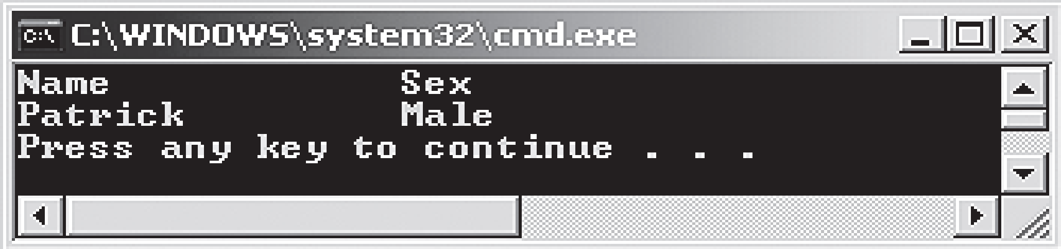
Overriding Virtual Methods in Generic Class 3-3
In the code:
The GeneralList class consists of a constructor that assigns the name of the student.
The GetValue() method of the GeneralList class is overridden in the Student class.
The constructor of the Student class invokes the base class constructor by using the base keyword and assigns the gender of the specified student.
The GetValue() method of the derived class returns the sex of the student.
The name of the student is invoked by using the base keyword to call the GetValue() method of the base class.
The StudentList class creates an instance of the Student class. This instance invokes the GetValue() method of the derived class, which in turn invokes the GetValue() method of the base class by using the base keyword.
The following figure shows the output of the code to override virtual methods for generic class:

Slide 46
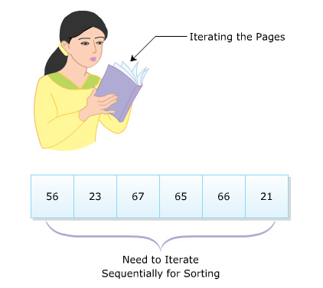
Iterators
Consider a scenario where a person is trying to memorize a book of 100 pages.
To finish the task, the person has to iterate through each of these 100 pages.
Similar to this person who iterates through the pages, an iterator in C# is used to traverse through a list of values or a collection.
It is a block of code that uses the foreach loop to refer to a collection of values in a sequential manner.
For example, consider a collection of values that needs to be sorted.
To implement the logic manually, a programmer can iterate through each value sequentially using iterators to compare the values.
An iterator is not a data member but is a way of accessing the member.
It can be a method, a get accessor, or an operator that allows you to navigate through the values in a collection.
Iterators specify the way, values are generated, when the foreach statement accesses the elements within a collection.
They keep track of the elements in the collection, so that you can retrieve these values if required.
Consider an array variable consisting of 6 elements, where the iterator can return all the elements within an array one by one.
The following figure illustrates these analogies:
Example

Slide 47
Benefits
For a class that behaves like a collection, it is preferable to use iterators to iterate through the values of the collection with the foreach statement.
By doing this, one can get the following benefits:
Iterators provide a simplified and faster way of iterating through the values of a collection.
Iterators reduce the complexity of providing an enumerator for a collection.
Iterators can return large number of values.
Iterators can be used to evaluate and return only those values that are needed.
Iterators can return values without consuming memory by referring each value in the list.

Slide 48
Implementation 1-3
Iterators can be created by implementing the GetEnumerator() method that returns a reference of the IEnumerator interface.
The iterator block uses the yield keyword to provide values to the instance of the enumerator or to terminate the iteration.
The yield return statement returns the values, while the yieldbreak statement ends the iteration process.
When the program control reaches the yield return statement, the current location is stored, and the next time the iterator is called, the execution is started from the stored location.

Slide 49
Implementation 2-3
The following code demonstrates the use of iterators to iterate through the values of a collection:
Snippet
using System;
using System;
using System.Collections;
class Department : IEnumerable
{
string[] departmentNames = {“Marketing”, “Finance”,
“Information Technology”, “Human Resources”};
public IEnumerator GetEnumerator()
{
for (int i = 0; i < departmentNames.Length; i++)
{
yield return departmentNames[i];
}
}
static void Main (string [] args)
{
Department objDepartment = new Department();
Console.WriteLine(“Department Names”);
Console.WriteLine();
foreach(string str in objDepartment)
{
Console.WriteLine(str);
}
}
}

Slide 50
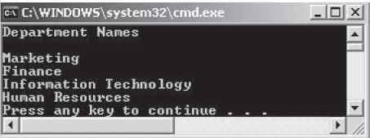
Implementation 3-3
In the code:
The class Department implements the interface IEnumerable.
The class Department consists of an array variable that stores the department names and a GetEnumerator() method, that contains the for loop.
The for loop returns the department names at each index position within the array variable.
This block of code within the GetEnumerator()method comprises the iterator in this example.
The Main()method creates an instance of the class Department and contains a foreach loop that displays the department names.
The following code displays the use of iterators:

Slide 51
Generic Iterators 1-3
C# allows programmers to create generic iterators.
Generic iterators are created by returning an object of the generic Ienumerator <T> or Ienumerable <T> interface.
They are used to iterate through values of any value type.
The following code demonstrates how to create a generic iterator to iterate through values of any type:
Snippet
using System;
using System.Collections.Generic;
class GenericDepartment<T>
{
T[] item;
public GenericDepartment(T[] val)
{
item = val;
}
public IEnumerator<T> GetEnumerator()
{
foreach (T value in item)
{
yield return value;
}
}
}

Slide 52
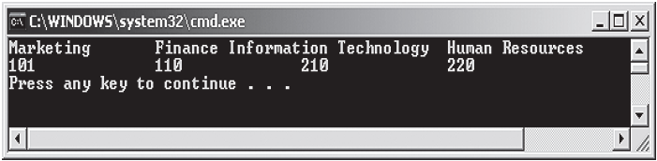
Generic Iterators 2-3
The following figure shows the output of the code to create a generic iterator:
class GenericIterator
{
static void Main(string[] args)
{
string[] departmentNames = { "Marketing", "Finance",
"Information Technology", "Human Resources" };
GenericDepartment<string> objGeneralName = new
GenericDepartment<string>(departmentNames);
foreach (string val in objGeneralName)
{
Console.Write(val + "\t");
}
int[] departmentID = { 101, 110, 210, 220 };
GenericDepartment<int> objGeneralID = new
GenericDepartment<int>(departmentID);
Console.WriteLine();
foreach (int val in objGeneralID)
{
Console.Write(val + "\t\t");
}
Console.WriteLine();
}
}

Slide 53
Generic Iterators 3-3
In the code:
The generic class, GenericDepartment, is created with the generic type parameter T.
The class declares an array variable and consists of a parameterized constructor that assigns values to this array variable.
In the generic class, GenericDepartment, the GetEnumerator() method returns a generic type of the IEnumerator interface.
This method returns elements stored in the array variable, using the yield statement.
In the GenericIterator class, an instance of the GenericDepartment class is created that refers to the different department names within the array.
Another object of the GenericDepartment class is created, that refers to the different department IDs within the array.

Slide 54
Implementing Named Iterators 1-2
Another way of creating iterators is by creating a method, whose return type is the IEnumerable interface.
This is called a named iterator. Named iterators can accept parameters that can be used to manage the starting and end points of a foreach loop.
This flexible technique allows you to fetch the required values from the collection.
The following syntax creates a named iterator:
where,
access_modifier: Specifies the scope of the named iterator.
IteratorName: Is the name of the iterator method.
parameter list: Defines zero or more parameters to be passed to the iterator method.
Syntax
<access_modifier> IEnumerable <IteratorName> (<parameter list>){}

Slide 55
Implementing Named Iterators 2-2
The following code demonstrates how to create a named iterator:
Ferrari
Mercedes
BMW
Toyota
Nissan
In the code:
The NamedIterators class consists of an array variable and a method GetCarNames(),whose return type is IEnumerable.
The for loop iterates through the values within the array variable.
The Main() method creates an instance of the class NamedIterators and this instance is used in the foreach loop to display the names of the cars from the array variable.
Snippet
using System;
class NamedIterators{
string[] cars = { “Ferrari”, “Mercedes”, “BMW”, “Toyota”, “Nissan”};
public IEnumerable GetCarNames() {
for (int i = 0; i < cars.Length; i++) {
yield return cars[i];
}
}
static void Main(string[] args) {
NamedIterators objIterator = new NamedIterators();
foreach (string str in objIterator.GetCarNames()) {
Console.WriteLine(str);
}
}
}
Output

Slide 56
Summary
Generics are data structures that allow you to reuse a code for different types such as classes or interfaces.
Generics provide several benefits such as type-safety and better performance.
Generic types can be declared by using the type parameter, which is a placeholder for a particular type.
Generic classes can be created by the class declaration followed by the type parameter list enclosed in the angular brackets and application of constraints (optional) on the type parameters.
An iterator is a block of code that returns sequentially ordered values of the same type.
One of the ways to create iterators is by using the GetEnumerator() method of the IEnumerable or IEnumerator interface.
The yield keyword provides values to the enumerator object or to signal the end of the iteration.

Slide 57

THANKS FOR WATCHING !

